Slide 1
T.O.U.C.H. PROGRAM
(Students)

Slide 2
WHAT IS T.O.U.C.H.?
T.O.U.C.H. stands for:
Translating Osteopathic Understanding into Community Health
The program is intended to reach out beyond our campus to the greater community
WHAT IS T.O.U.C.H.?
Service does not have to be medically related

Slide 3
TOUCH PROGRAM
The T.O.U.C.H. program encourages osteopathic medical students across the country to become more involved in active community service
In this program, students are recognized for their time spent improving the health and wellness of the community
AWARDS are given at the end of the year which includes a certificate from the national COSGP office.
MSPE: A letter of commendation will also be sent from the President of AACOM to the TouroCOM Dean on your behalf! It will suggest the Dean’s inclusion of your commitment to service in your MSPE. Your service WILL set you apart from other residency applicants!
TOUCH PROGRAM
Participant Award | Silver Award | Gold Award | Platinum Award
1+ Hours | 50+ Hours | 100+ Hours | Student w/ highest # of hours
(Includes all class years)
Example:
49.5 Hours 🡪 Participant Award
50.1 Hours 🡪 Silver Award
Once these thresholds are met you will receive a certificate that summer!

Slide 4
TOUCH HOURS
V O L U N T E E R
H O U R S
VS
The event must provide a service to the community in order to be TOUCH eligible
Does not meet T.O.U.C.H. criteria
Does not involve community outside TouroCOM
Services that do not directly work to improve the health and wellness of a local or global community
Provides service to osteopathic/medical community
Any activity that works to improve the health and wellness of a community outside of the medical school coursework
Services will not count if they are…
Compensated
Self-serving
Directly benefiting medical students or the school
Court mandated “Community Service” does not count towards TOUCH hours

Slide 5
TOUCH HOUR EXAMPLES
Habitat for Humanity
Big Brother/Sister program
Soup Kitchen/Food Pantry
Mission Trips
Appalachian Outreach
Hospice
Online tutoring
Participating on a Volunteer Rescue Squad
Blood Drives
Running a prevention clinic
Hosting an event that is fundraising for a community organization i.e. chili cook off
Shot clinics that are open to the public (can't be just offered to TouroCOM)
Local Trash Collection
Any event that benefits the community outside of TouroCOM
Community service activities can be associated with COM student organizations or external organizations.
Others… Use your judgment!
If not sure, please email me!

Slide 6
VOLUNTEER HOUR EXAMPLES
Peer Tutoring within TouroCOM
Shot Clinics that are for TouroCOM only
Bringing in a Speaker to the school in you are the event planner
Giving tours as a TouroCOM Student Ambassador
Participating in Q/A panel sessions for TouroCOM
SIM Labs
Small group leadership

Slide 7
FUNDRAISING
Fundraising CAN count IF and ONLY IF there is an actual EVENT held to raise money or supplies for a community organization.
Ex. Bake sale for Breast Cancer Awareness, cook off etc.
Only volunteering for the event or baking goods qualifies for TOUCH.
Buying goods/donating at the event or prior to the event does not qualify for TOUCH.
For fitness events, only volunteering for the event qualifies. Participation does not qualify for TOUCH
The event can involve the community or be only for TouroCOM if the items raised do not go towards TouroCOM and its organizations. The items/money raised must support an outside organization. Only then can fundraising hours count.
Translation: ALL of the funds raised during the event must be given to a charity or charitable cause)
If you simply collect money for a philanthropic cause with no associated EVENT, it will not count towards TOUCH hours.
Ex. I’m going to sell popcorn or ask for monetary donation on my own time to raise money for March of Dimes. (DOESN’T COUNT- No event associated with raising funds)

Slide 8
DONATION DRIVES
The maximum number of TOUCH hours a student can claim per Donation Drive is 2 TOUCH hour regardless of how many things they donate.
***Students are only allowed to collect a total of 10 TOUCH hours per cycle year for donations drives (including blood drives)
Volunteers and coordinators can log as many hours as it takes to moderate or run the event.
Planning hours will still be 1 planning hour= 0.5 TOUCH hours.
Donation minimum for one TOUCH hour is set at a value <$10 by the club/organization.
Donations are NOT monetary.
Donations are collected to benefit the community NOT TouroCOM.
Students can donate as many or as little things as possible as long as it meets the minimum criteria set by the club.

Slide 9
WHAT DOESN’T COUNT AS TOUCH HOURS?
Leadership responsibilities in student organization will not count towards TOUCH hours unless those responsibilities involve participation in a specific community service activity.
Normal student organization activities (such as meetings, bringing in speakers, etc.) are not considered community service.
Fundraising: simply collecting money for a philanthropic cause will not suffice as an activity/event/community service
TOUCH credit will not be given for volunteering in research or shadowing, as TOUCH is meant to encourage activity and health/wellness in the community
Personal favors such as driving someone to an appointment or helping someone move is admirable, but ineligible for TOUCH.
Event for TouroCOM (ex. Helping set up graduation)

Slide 10
WHAT DO I NEED TO DO WHEN LOGGING TOUCH Hours?
Ensure your service hours meets the TOUCH Requirements for community involvement
Email montanasga@gmail.com if you are unsure if your service hours qualifies for TOUCH.
Submit your hours to TRACK IT FORWARD within ONE MONTH of your service date.
Do not batch submit your hours in one form. Each event and service date must have it's own submission.
Ex. You volunteered for the food bank on Wednesday, Friday, and Saturday. Each date must have it’s own submission for a total of 3 submissions.
Log your hours even if you do not think you will reach 35 hours because you might surprise yourself and realize that you are almost at 35 by the end of the TOUCH calendar year!
Touch Hour Cycle: May 1st, 2024 – April 30th, 2025

Slide 11
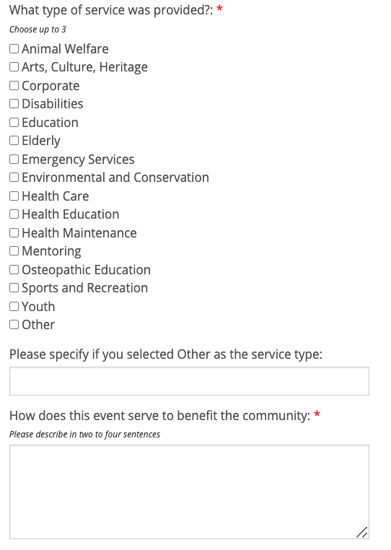
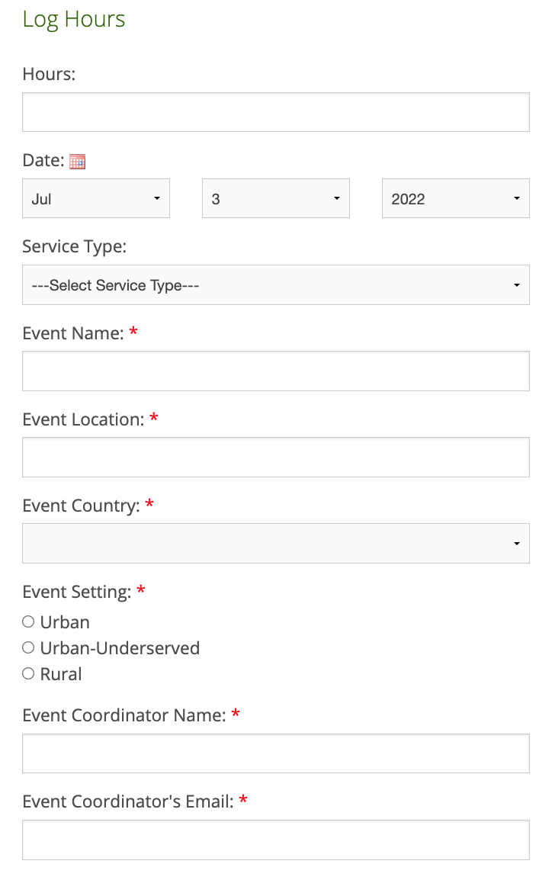
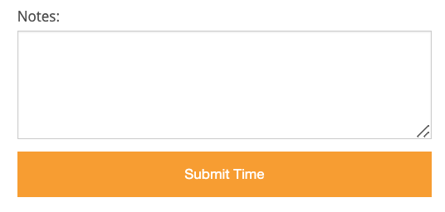
TRACKITFORWARD
Information needed to submit hours https://www.trackitforward.com/site/tourocom-ny-middletown
Purpose of the event
What role did you play?

Slide 12
TIPS & REMINDERS
Try to join as many clubs as possible. They provide a lot of great volunteer opportunities and will open them to their members first!
Keep a personal log of your own hours separately from the website (in case of a crash or an error occurs)
If there are any problems with your submission the TOUCH Coordinator will reach out to you
Don’t panic if your hours are not approved right away, it takes time to review and process each submission!

Slide 13
WEBSITES TO KNOW
Track It Forward Tracker Website:
https://www.trackitforward.com/site/tourocom-montana
How to Use Track It Forward:
https://www.trackitforward.com/how-it-works
Touch Program Protocols:
https://www.aacom.org/docs/default-source/become-doctor/touch-rules-regulations.pdf

Slide 14
QUESTIONS OR CONCERNS?
Contact:
TouroCOM-Montana Campus TOUCH Coordinator: Melisa Fletes
SGA email: montanasga@gmail.com

